Slide 1


Data Analysis

Slide 2


Today's agenda
Project recap
ProblemProcess
Insights
Summary

Slide 3


We want to know the top categories that the users of our clients platform are mostly interested. We, as data analysis team, need to focus on cleaning and extracting the data for our clients in graphical and easy to understand manner.
Project Recap

Slide 4


Problem
The provided data has missing values and misleading column names. So first we impute the missing values and correct the column names and merge the data into single dataset.

Slide 5

Process
1
Loading the data
2
Initial Look at Data
3
Cleaning the data
4
Performing Statistical Analysis
5
Displaying Graphical Form for the data

Slide 6


Insights
After cleaning the data we ran Exploratory analysis and found the top categories that interests most people on the platform. This can be understood by the graph shown on next slide.

Slide 7
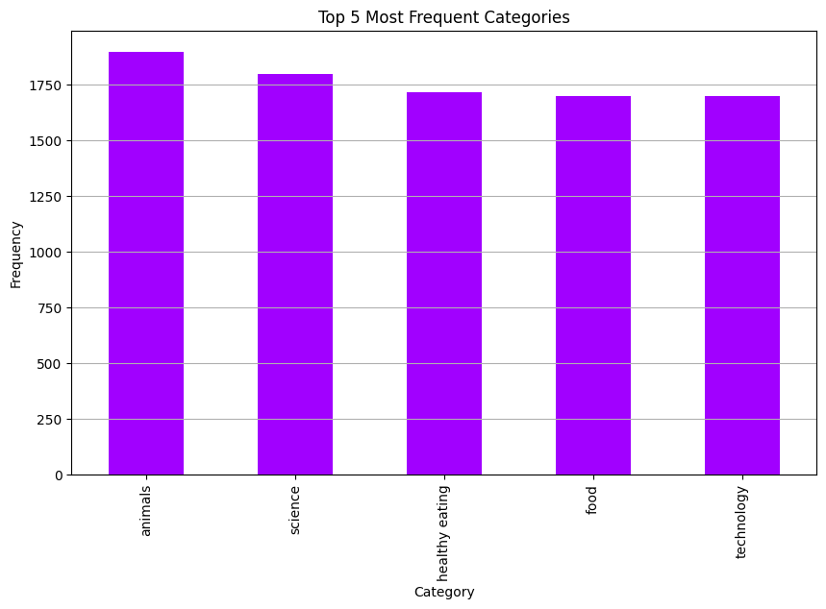

Slide 8


By the analysis, we came to know that the top 5 categories that interest the users are:
Animals
Science
Healthy Eating
Food
Technology
Summary

Slide 9

Thank you!
ANY QUESTIONS?

